Slide 1
타겟층 분석
이동준

Slide 2
Software Online classes
Because of the Covid-19,
More than half of the lectures are conducted online.
And the majority of students use i-campus.
Distribution of software major classes
in 2021 spring

Slide 3
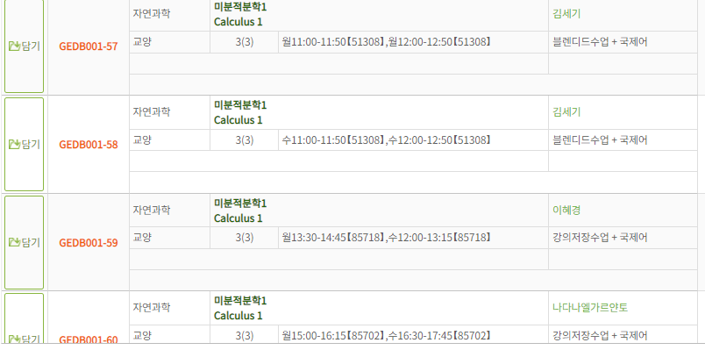
After the Covid-19 ?
Even before Covid-19, Many students used i-Campus lectures. Due to online lectures, lecture storage classes, and flipped classes.
And we think that there will be many classes using i-Campus due to the more established systems than before.
Classes in 2019 fall (Before Covid-19)

Slide 4
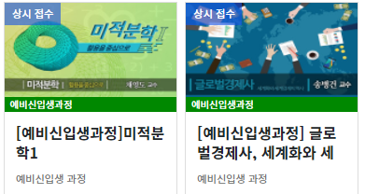
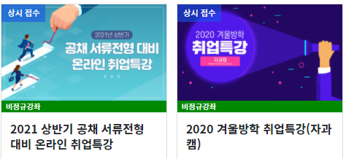
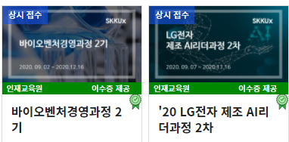
Users other than current students
In i-Campus S-mooc also provides lectures for not currently enrolled students
(freshmen, graduate and others)

Slide 5

Because of the systems built by the covid-19, we think that students will use it in a number of lectures even after the covid-19 is over.
And due to the expanded i-Campus, we think that many users other than current students will also use it.

